Slide 1
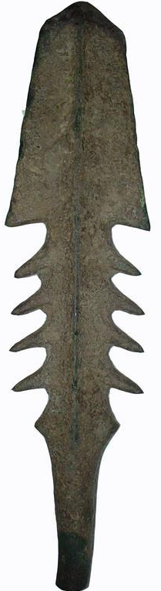
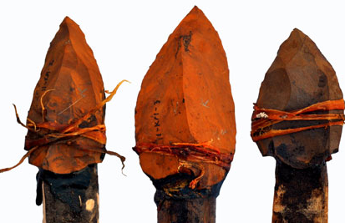
Primary & Secondary Sources
Starter:
Imagine you’re a historian trying to find out about Ice Age life & you’ve discovered these artefacts.
Are they useful?
Can these artefacts tell you anything about the lifestyle of the people who created & used them?
If so, what?
Ice Age weapons: flint points lashed to wooden handles and a harpoon made from an antler. Between 18 000 & 10 000 BCE.

Slide 2
What’s the difference between primary & secondary sources?:
http://prezi.com/pwtldbkerrkx/primary-and-secondary-sources-presentation/
Primary Source:
An authentic document or original item that was produced at the time of the events you are studying.
It was created by someone who lived at the time and is therefore a great source of records or evidence.
E.g- The Great Pyramid of Giza is a primary source from Ancient Egypt.
Secondary Source:
A description, report or recording about the past that was produced after the events being studied took place.
It may contain an opinion, as the author may have wanted to express their point of view on the topic.
E.g- An encyclopaedia article about the Great Pyramid of Giza is a secondary source on Ancient Egypt.

Slide 3
Are YOU Source-Savvy?
Class competition time!
Your teacher will give you an A4, laminated, red/blue laminated card.
8 pictures of a mixture of primary or secondary sources will flash up on the screen. For each one, you need to hold up your RED CARD for PRIMARY SOURCE or BLUE CARD for SECONDARY SOURCE.
Careful, though! You MUST be sure of your decision. Your teacher will be choosing people at random to JUSTIFY their answer. (Explain why they think what they do). So don’t just be a crowd follower!

Slide 4
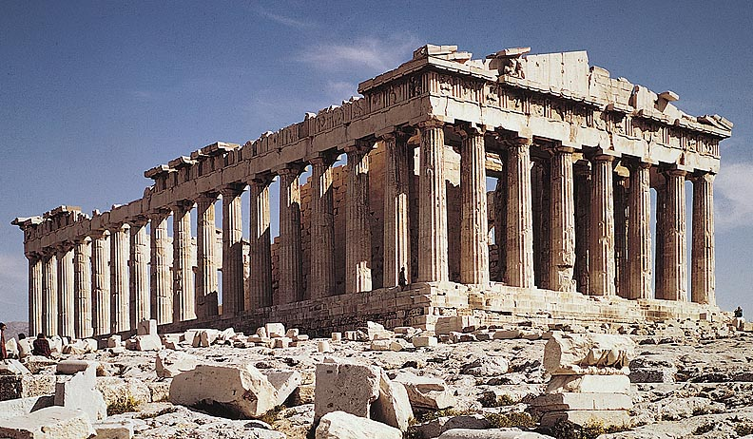
Greek Parthenon. 447 BCE.
Primary Source

Slide 5
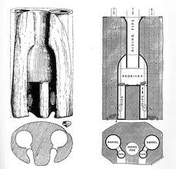
1789 Illustration of Ancient Roman water pump.
Secondary Source

Slide 6
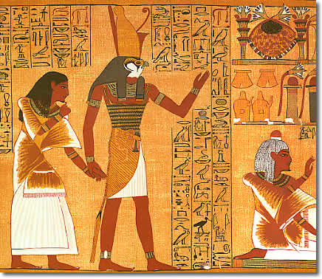
Ancient hieroglyphic script.
Primary Source

Slide 7
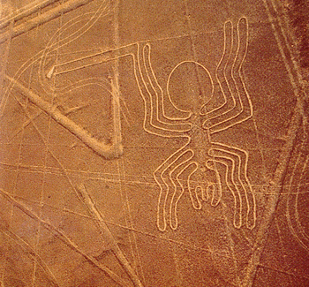
Peruvian earth drawings:
Primary Source

Slide 8
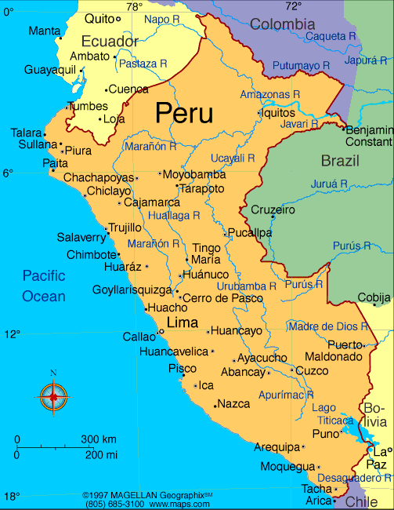
Map showing the site of ancient Peruvian earth drawings
Secondary Source

Slide 9

Remains of the Titanic
Primary Source

Slide 10
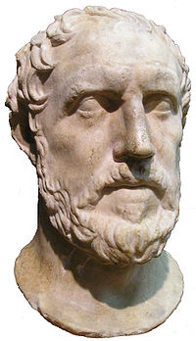
Thucydides, Ancient Greek general, writing about the Peloponnesian War at the time.
Primary Source

Slide 11

YOU, creating a screencast on the Peloponnesian War.
Secondary Source

Slide 12

Task:
Historical Information- where does it come from?
Trim, glue and have your pencil ready- we will go through this worksheet together as a class.

Slide 13
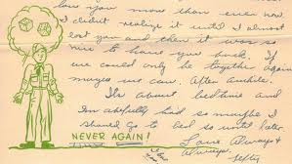
Plenary: Exit Card
A letter from an American soldier to his family during WWII, c 1942.
Primary or Secondary source? Why?

